Slide 1
Inception Time
Finding AlexNet for Time Series Classification

Slide 2
Agenda
Brief introduction
Time series data
Model architecture and running the experiment
Experiment result

Slide 3
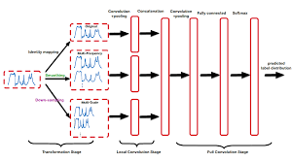
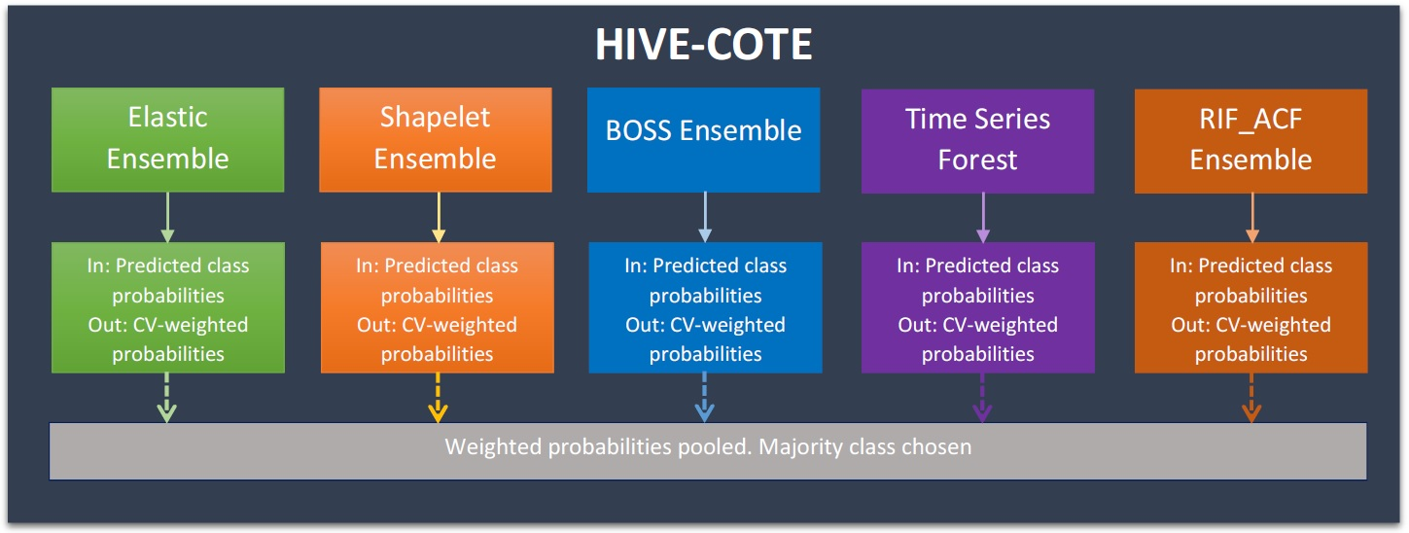
Brief Introduction
Time series classification (TSC) – assign labels to time series
Applications include health care(disease recognition) , human activity sensing, forecasting, etc
Traditional TSC HIVE-COTE algorithm at 2016– long training time limitation
Last few years, start applying deep learning models on TSC
InceptionTime - an ensemble of CNN models
Higher accuracy , lower training time

Slide 4
takeaway
Takeaway – 1
Takeaway – 2
Takeaway – 3

Slide 5
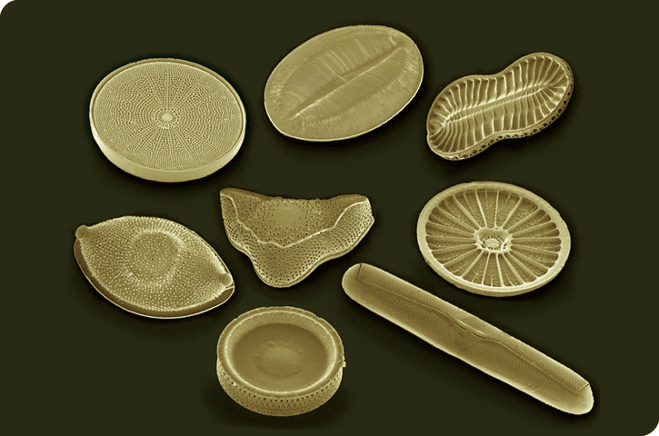
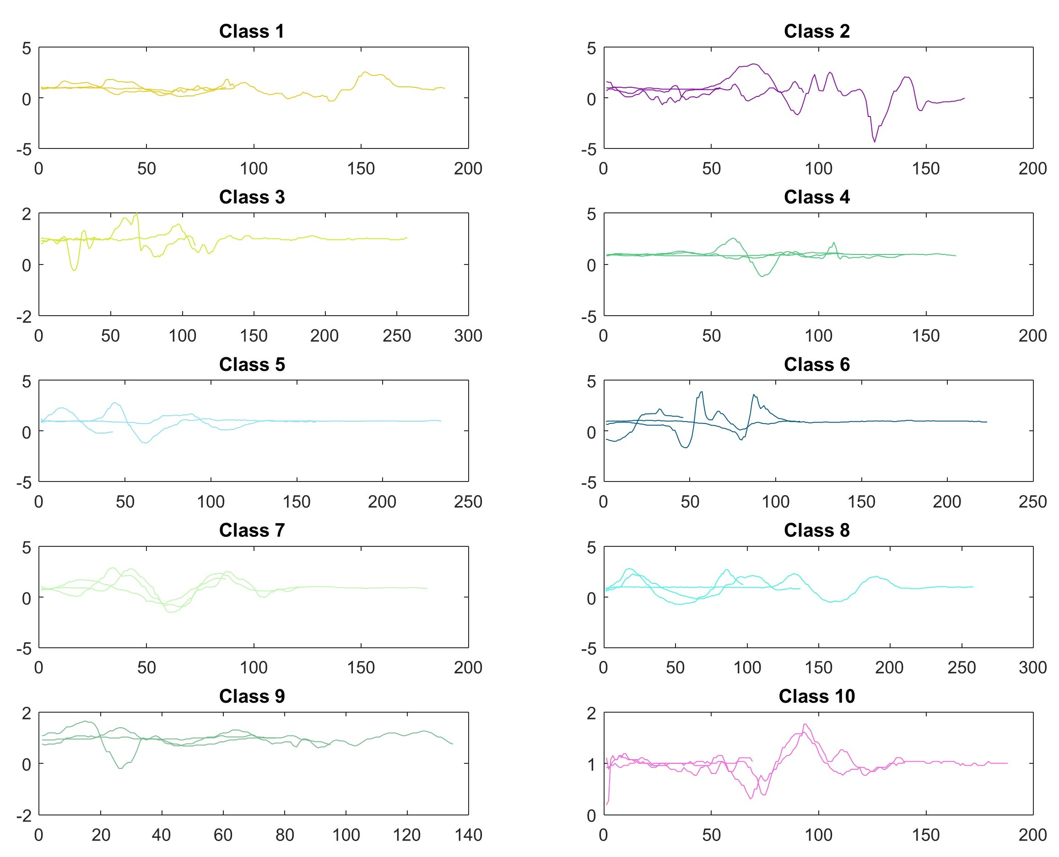
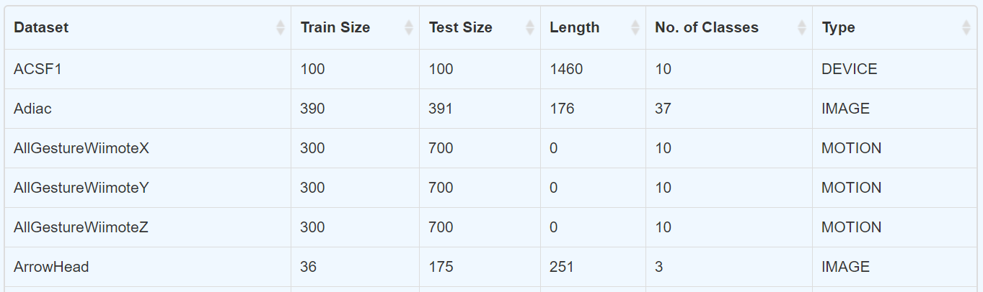
Dataset
85 archives on UCR/UEA archive
Types: Image, sensor, electrocardiogram (ECG), spectro, etc
three chosen archives: Adiac (image), beef (spectro) and meat (spectro)

Slide 6
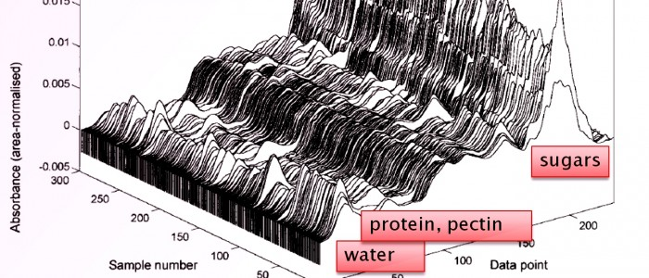
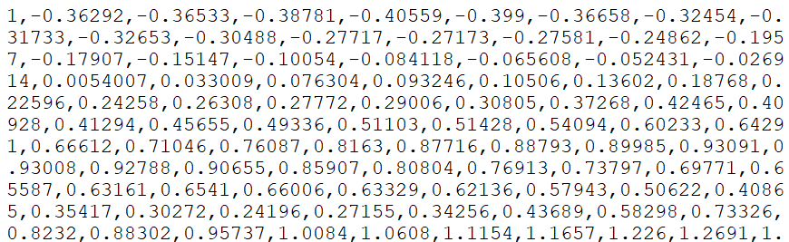
Archive - beef
Food spectrographs are used in chemometrics to classify food types, a task that has obvious applications in food safety and quality assurance
Classes vary from pure beef and beef adulterated with varying degrees of offal
Training data

Slide 7
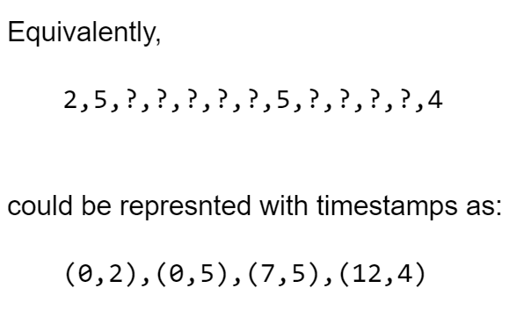
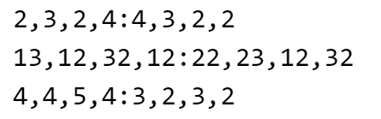
Timestamp
Time series data represenation
3 cases, 2 dimensions, 4 observations per dimension
(timestamp , value)
Missing reading is specified as ?

Slide 8
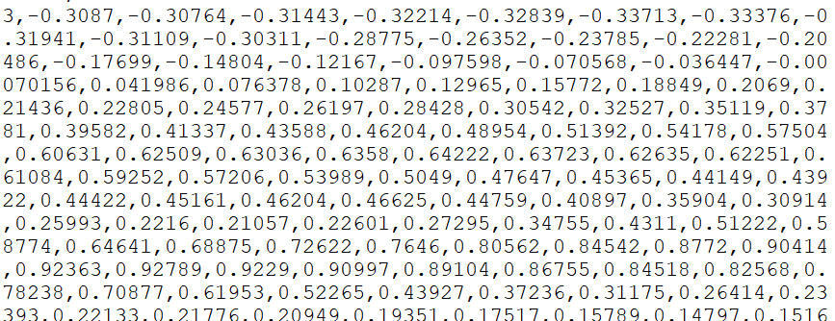
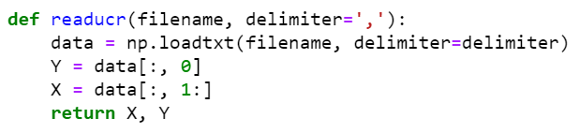
Data format
Takeaway – 1
Format of time series data with hidden timestamp
(timestamp , value)
Training data – class 1
value at each timestamp
Training data – class 3

Slide 9
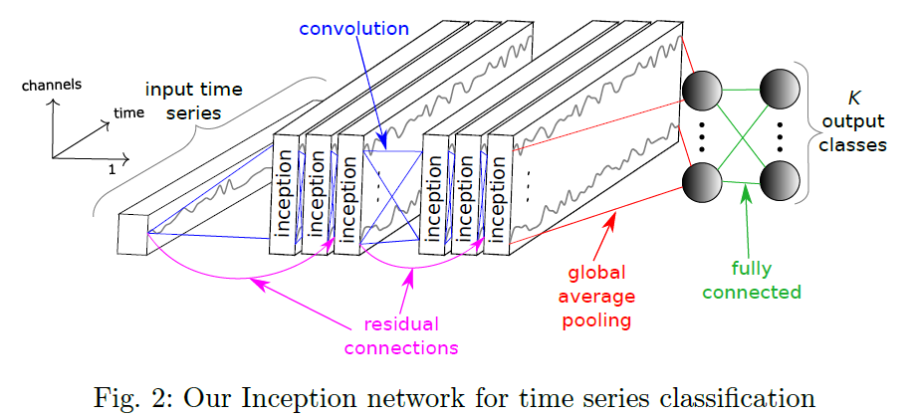
Model architecture
6 different inception modules stacked together
Residual blocks are connected between modules to mitigate vanishing gradient problem
Average pooling to summarize the average presence of a feature

Slide 10
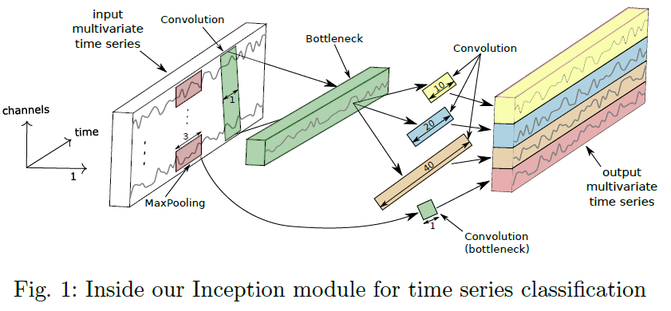
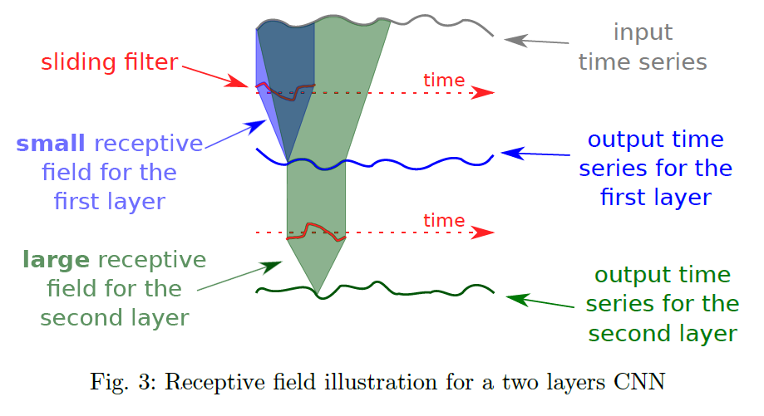
Inception layer
Inside inception module, there is a bottleneck layer, to reduce dimensionality of time series & overfitting problem for small dataset => allow longer filter for larger receptive field
Multiple filters of different lengths are applied to capture features
Takeaway – 2
1D CNN is good for extracting features from short segments at different segment locations. Various length of filters used to capture different features

Slide 11
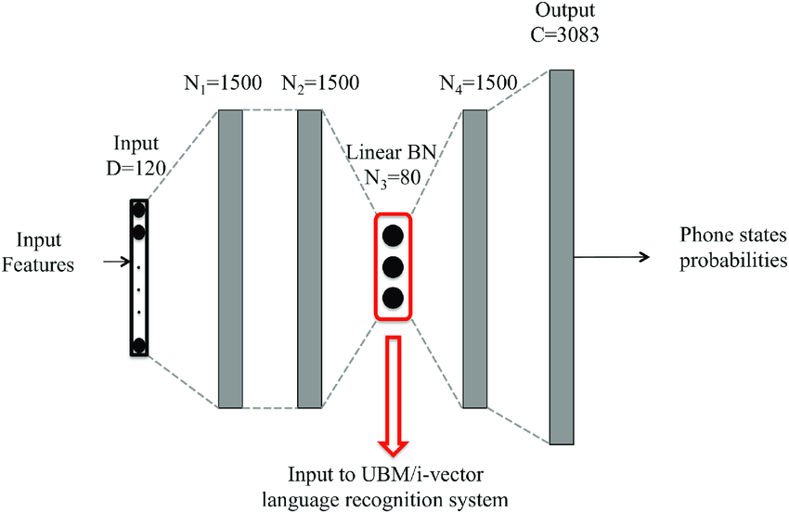
Bottleneck layer

Slide 12
Experiment setup
Synthetic dataset
Control length of time series
Number of classes
Distribution of classes in time
Hyperparameter study
Batch size
bottleneck
Residual connection
Depth
Filter length
Number of filters
Algorithm study
HIVE-COTE
vs
InceptionTime

Slide 13
Files provided on Github
Main.py – code to run the experiment
Utils folders – to read dataset and visualize plots
Classifier folder
Inception.py – contain inception networks
Nne.py – ensemble a set of inception networks

Slide 14
First attempt – local machine
Installing requirement.txt
Virtual env
Hard to follow the version control
GPU limitation – local machine (GeForce MX150)
Resort to Colab for GPU resources
Takeaway – 3
Try running the code first before worrying about the version control

Slide 15
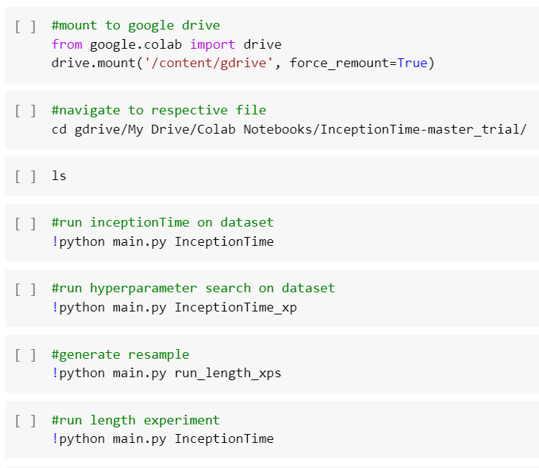
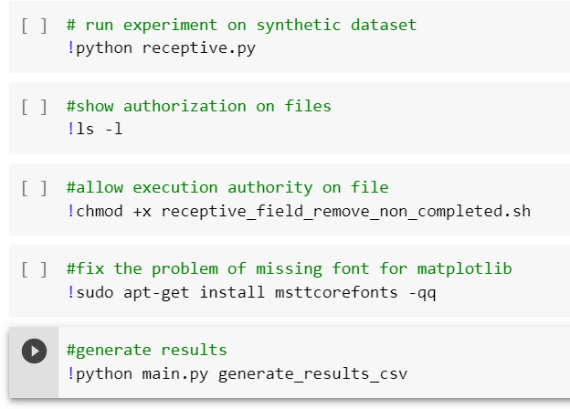
Running the experiment

Slide 16
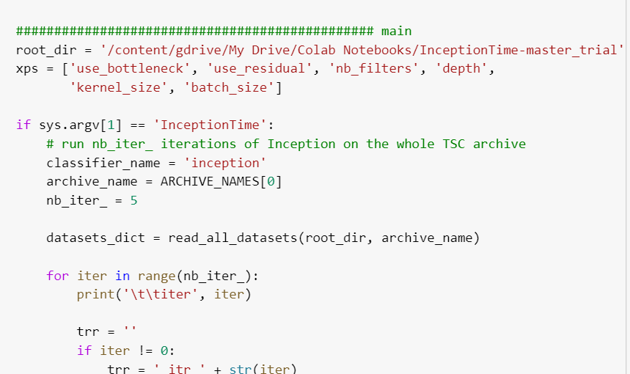
Change root_dir at main.py

Slide 17
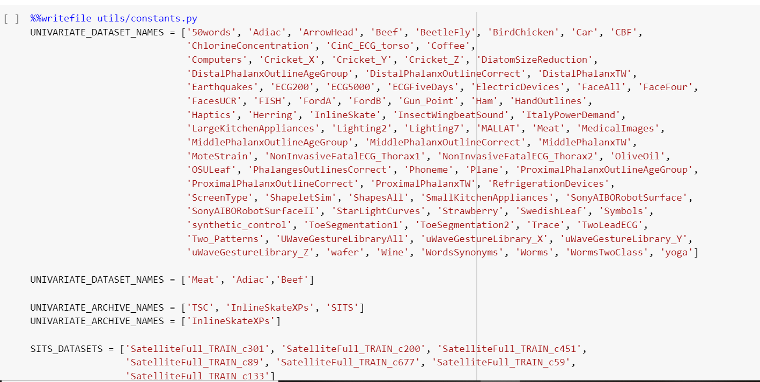
Select archives

Slide 18
Result
Result of my model trained on 3 datasets
Dataset | precision | accuracy | recall | duration
Adiac | 0.8504601886 | 0.8465473146 | 0.851972127 | 3.155848026
Beef | 0.7805555556 | 0.7 | 0.7 | 4.002893686
Meat | 0.9523809524 | 0.95 | 0.95 | 3.133121967
Result of github model trained on 85 datasets
 | classifier_name | archive_name | dataset_name | precision | accuracy | recall
32 | InceptionTime | TSC | Adiac | 0.8537939538 | 0.8363171355 | 0.8417390042
65 | InceptionTime | TSC | Beef | 0.7805555556 | 0.7 | 0.7
124 | nne/inception/use_bottleneck/False-0-1-2-3-4- | TSC | Meat | 0.9214340198 | 0.9166666667 | 0.9166666667

Slide 19
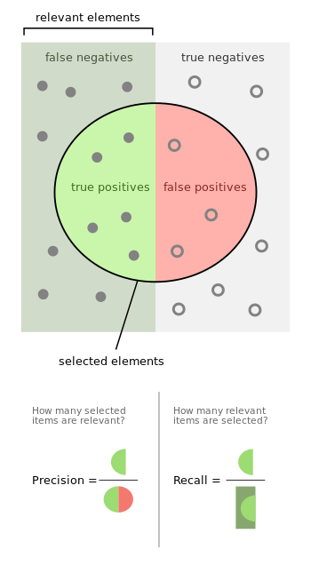
Precision vs recall

Slide 20
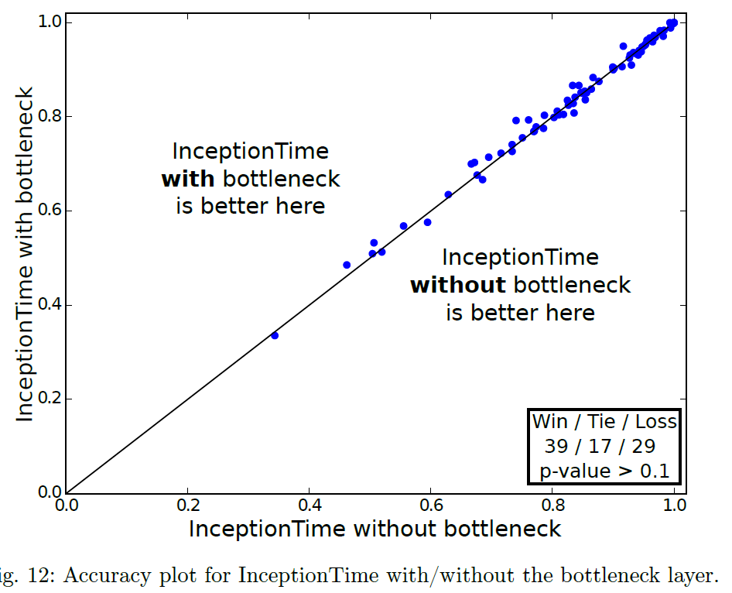
Experiment result
Hyperparameter study
Batch size (no significant impact on accuracy)
bottleneck (no significant impact on accuracy) (decrease in number of parameters, less complexity, shorter training time)

Slide 21
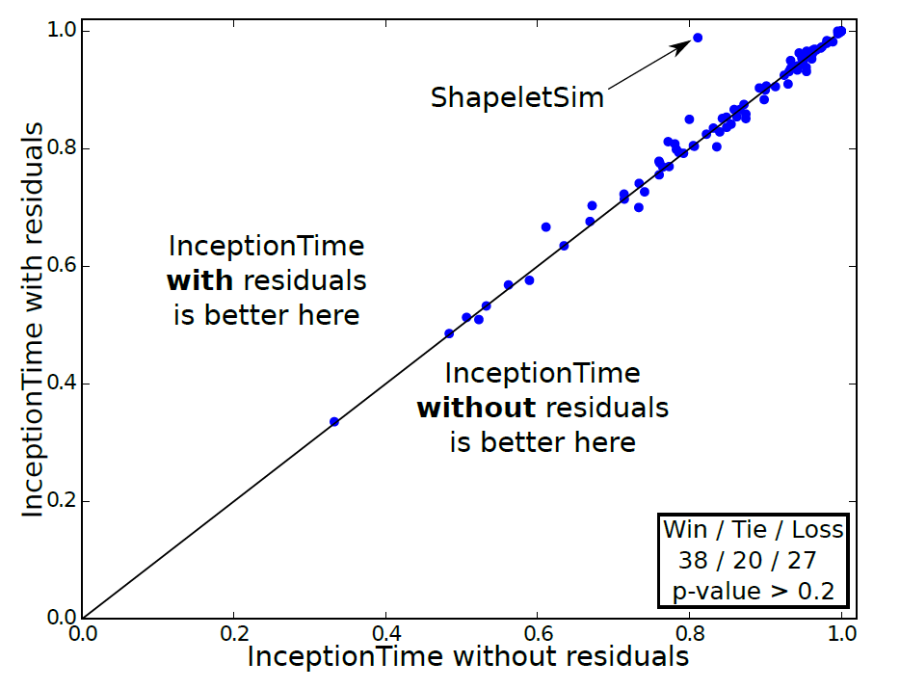
Experiment result
Hyperparameter study
Batch size (no significant impact on accuracy)
bottleneck (no significant impact on accuracy)
Residual connection (no significant impact on accuracy) (improve convergence rate without altering accuracy)

Slide 22
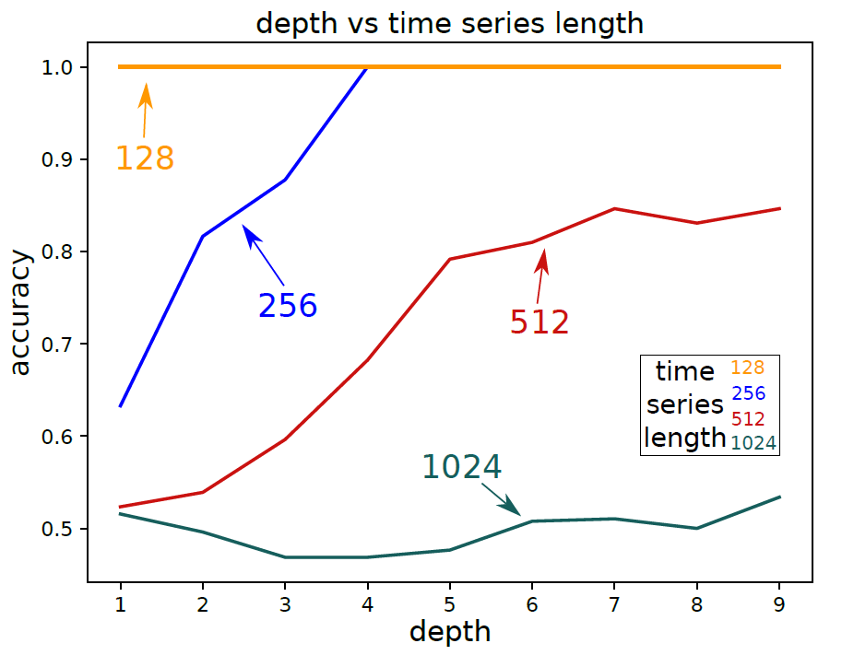
Experiment result
Hyperparameter study
Batch size (no significant impact on accuracy)
bottleneck (no significant impact on accuracy)
Residual connection (no significant impact on accuracy)
Depth (positive impact on accuracy with synthetic dataset) (no significant effect on real dataset, possibly overfitting)

Slide 23
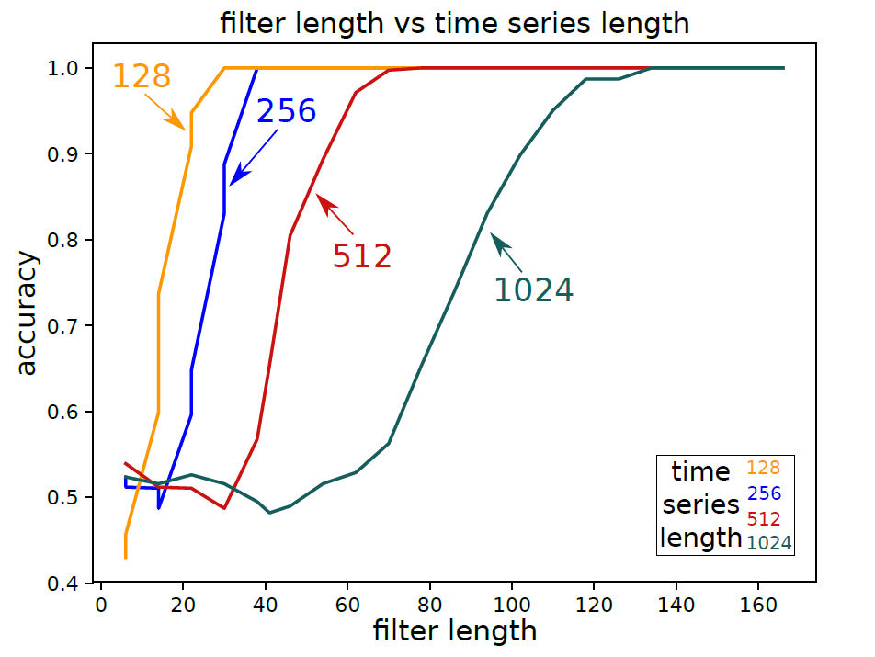
Experiment result
Hyperparameter study
Batch size (no significant impact on accuracy)
bottleneck (no significant impact on accuracy)
Residual connection (no significant impact on accuracy)
Depth(no significant effect on real dataset, possibly overfitting)
Filter length (positive impact on accuracy)

Slide 24
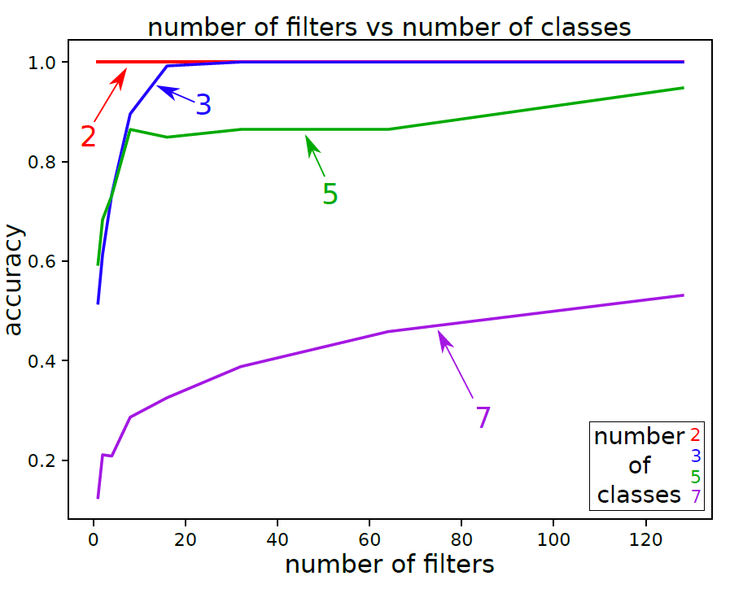
Experiment result
Hyperparameter study
Batch size (no significant impact on accuracy)
bottleneck (no significant impact on accuracy)
Residual connection (no significant impact on accuracy)
Depth(no significant effect on real dataset, possibly overfitting)
Filter length (positive impact on accuracy)
Number of filters (positive impact on accuracy) (side effect: explosion in parameters, overfitting)

Slide 25
Takeaway
Takeaway – 1
Format of time series data with hidden timestamp
(timestamp , value)
Takeaway – 2
1D CNN is good for extracting features from short segments at different segment locations. Various length of filters used to capture different features
Takeaway – 3
Try running the code first before worrying about the version control

Slide 26
END

